Slide 1
Teaching Code Through Zine
Jessica Garson

Slide 2
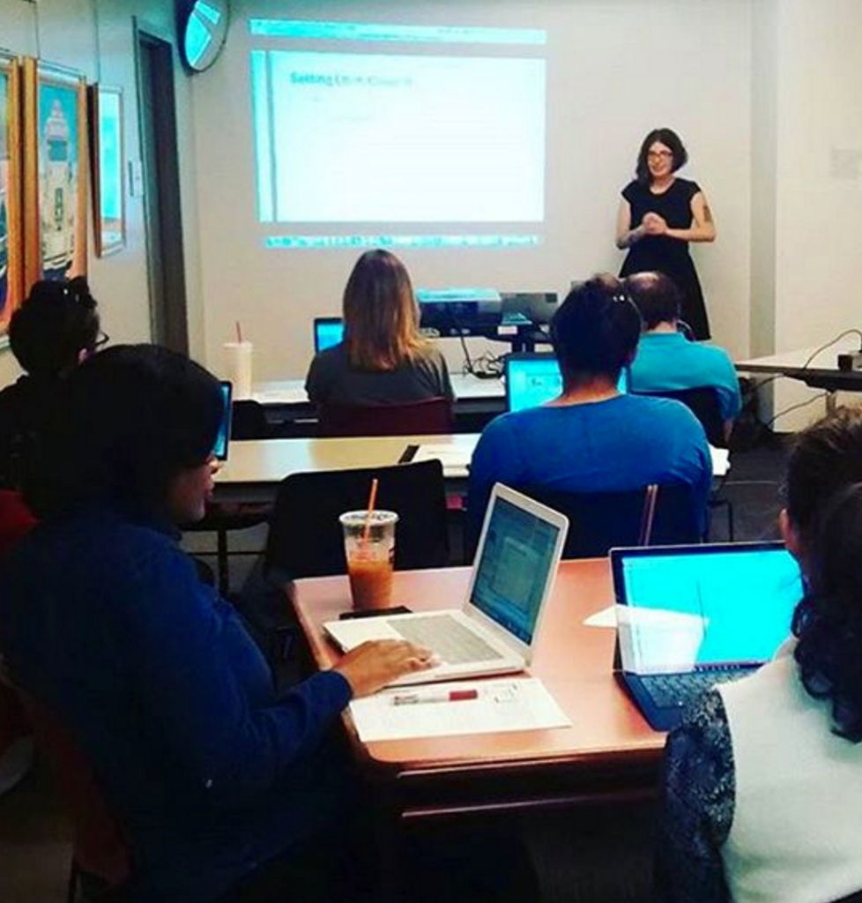
My Story

Slide 3

Origins

Slide 4
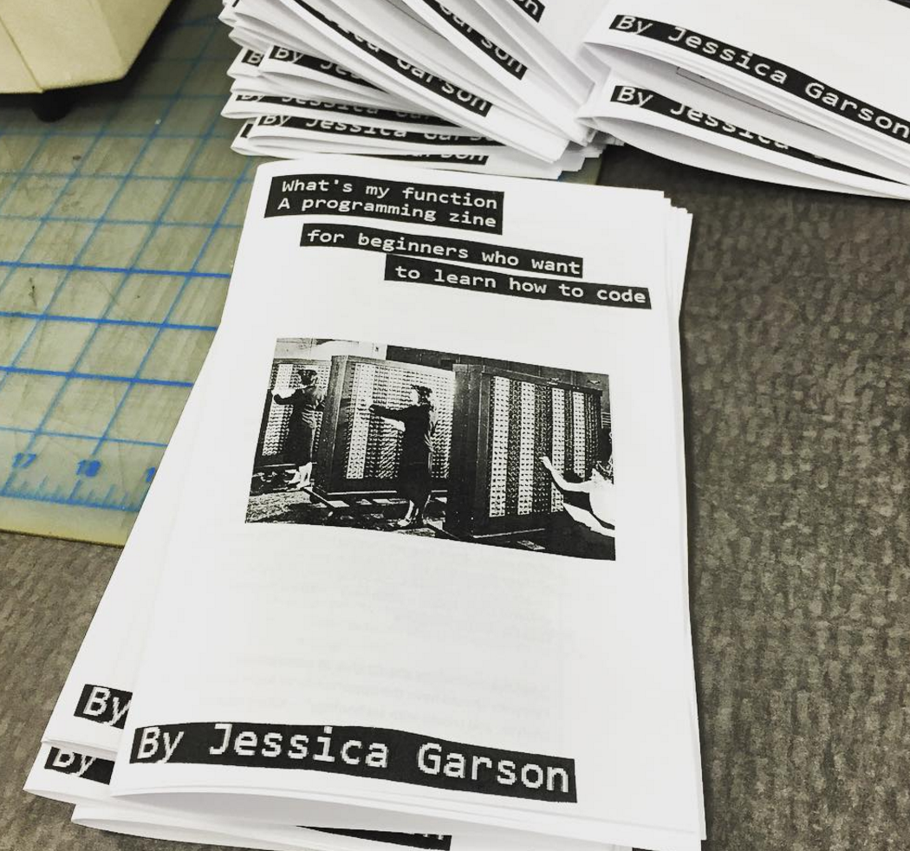
Version 1.0

Slide 5
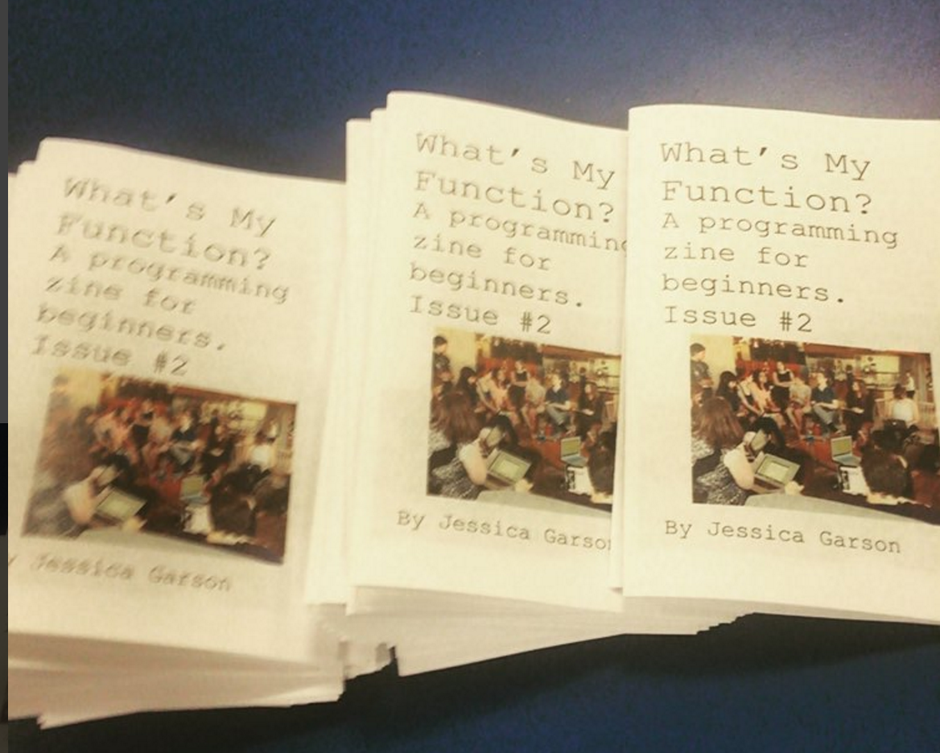
Version 2.0

Slide 6
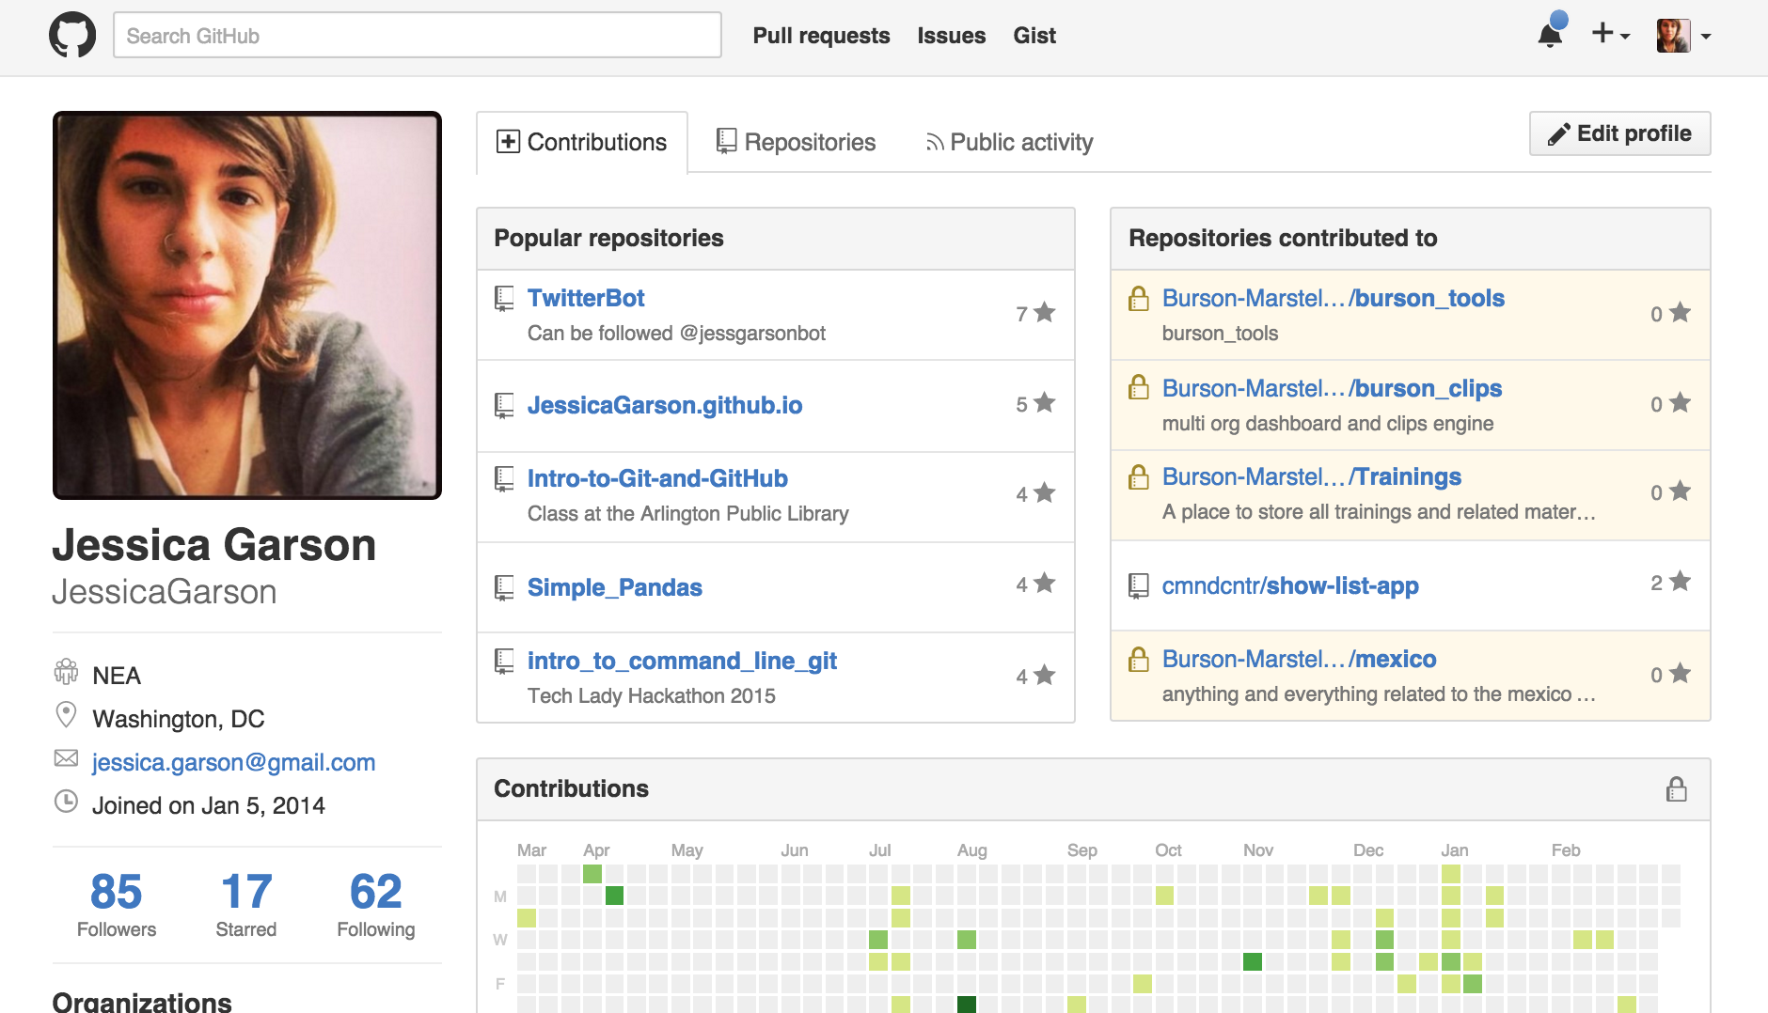
The great debate with myself

Slide 7
What’s next
Contribute – email me at jessica.garson@gmail.com
Others do this too – maybe I’ll combine efforts with them

